Slide 1
Dark hedgehog
Laura M.
3rd year of elementary school Dohnany

Slide 2
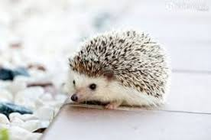
It lives
in forests, in fields and meadows
Lesoch , na lúkach a poliach

Slide 3
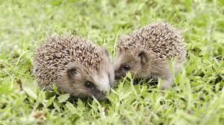
The dark hedgehog has got
body covered with needles under which he has fine fur

Slide 4
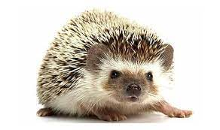
Dark hedgehog
His body is brown and gray
The ends of the needles are yellow

Slide 5
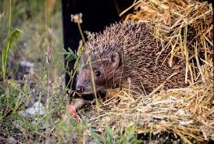
Did you know?
He has poor eyesight, but very good smell
When he is in danger, they huddled together
They are protected by law

Slide 6
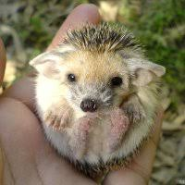
Reproduction
The young are born alive and during birth they have prickles under the skin so as not to injure the mother.
When hedgehog cubs are born, they drink breast milk.

Slide 7
Breathing
They breathe through their lungs through their noses.

Slide 8
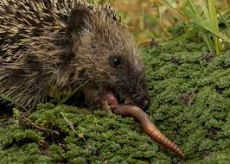
Food
They feed on earthworms, insects, snails...

Slide 9
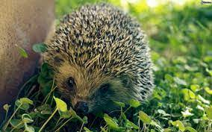
They're moving
They move by moving the hind and front legs.

Slide 10
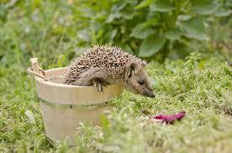
Did you know?
The dark hedgehog has a noisy sound – wheeze, whistle, eat loudly.

Slide 11
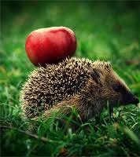
Básnička o ježkovi
Lezie ježko, lezie v lese jabĺčka si domov nesie. Deti v lese behajú ježka všade hľadajú. Lezie ježko, lezie v lese jabĺčka si domov nesie. Pichá sem a pichá tam, ja sa pichnúť nenechám. Lezie ježko, lezie v lese jabĺčka si domov nesie. Do lístia sa zahrabal, schúlil sa a tíško spal.

Slide 12
Take a look
https://youtu.be/ppmxR9IX8ug

Slide 13
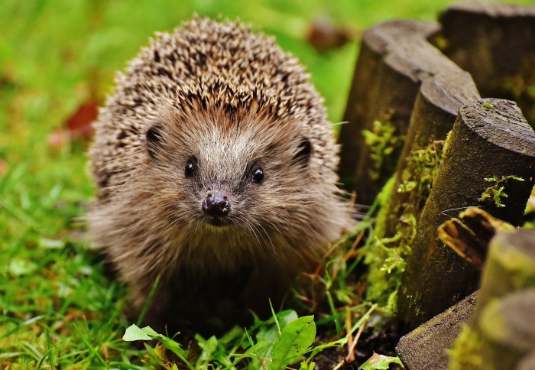
Thank you for attention

